Slide 1






Nomad Team
Machine Learning Project
INT3405E_56
December
22nd 2024
Problematic Internet Use

Slide 2







)
)
)
MEET THE TEAM
)
)
)
)
22028326
22028214
20020152
)
)
)
)
)
)
)
)
)
)
Đào Thị Bình An
Bùi Thị Huyền Tâm
Đoàn Minh Quân
)

Slide 3





Table of content
1. Introduction
2. Methodology
2.1. Exploratory Data Analysis (EDA)
2.2. Preprocessing & Feature engineering
2.3. Model Selection & Evaluation Metrics
2.4. Model implementation
3. Result
3.1. Prediction result
3.2. Comparision

Slide 4

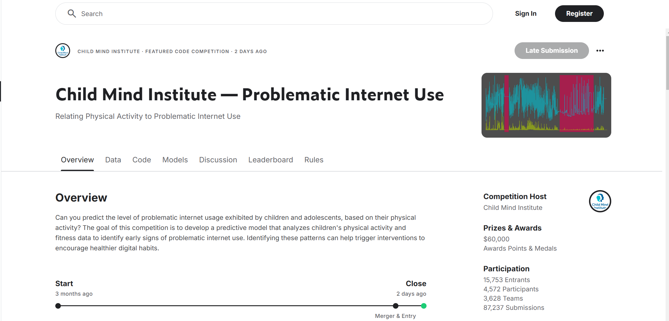


INTRODUCTION

Slide 5
Nomad Team
Introduction
Project Description
Motivation
Goal
Apply machine learning techniques to a real-world dataset.
Gain insight into the entire process of data preprocessing, feature engineering, model building, and evaluation.
Develop essential skills in handling machine learning projects through hands-on experience.
Participation in the Kaggle competition "Child Mind Institute — Problematic Internet Use".
Develop a predictive model to analyze children’s physical activity data and predict levels of problematic internet usage.
)
)
Build a simple machine learning model to predict problematic internet usage based on the provided dataset.
Learn key concepts and iteratively improve the model for better performance.
)
)
)
)
)
)
)
)
)
)

Slide 6



Dataset
)
)
)
)
)
)
Tabular Data:
Actigraphy Data
)
)
Files: train.csv and test.csv
Includes demographic, physical, and behavioral measurements collected through various instruments in data_dictionary.csv
Some key features:
Demographics: age, sex
Physical Measures: Blood pressure, heart rate, height, weight, and waist/hip measurements.
PCIAT: 20-item scale measuring characteristics and behaviors associated with compulsive use of the internet
sii: Derived target, categorized (0-3)
)
)
Files: series_train.parquet and series_test.parquet
Accelerometer data collected from wrist-worn devices.
Some key features:
X, Y, Z: Acceleration measurements along the three axes.
enmo: indicating motion intensity.
light: Ambient light measured in lux.
non-wear_flag, Time of day, Day of the week, Battery voltage,...
)
)
)
)
)
)
)
)
)
)
)
)
)
)
)

Slide 7
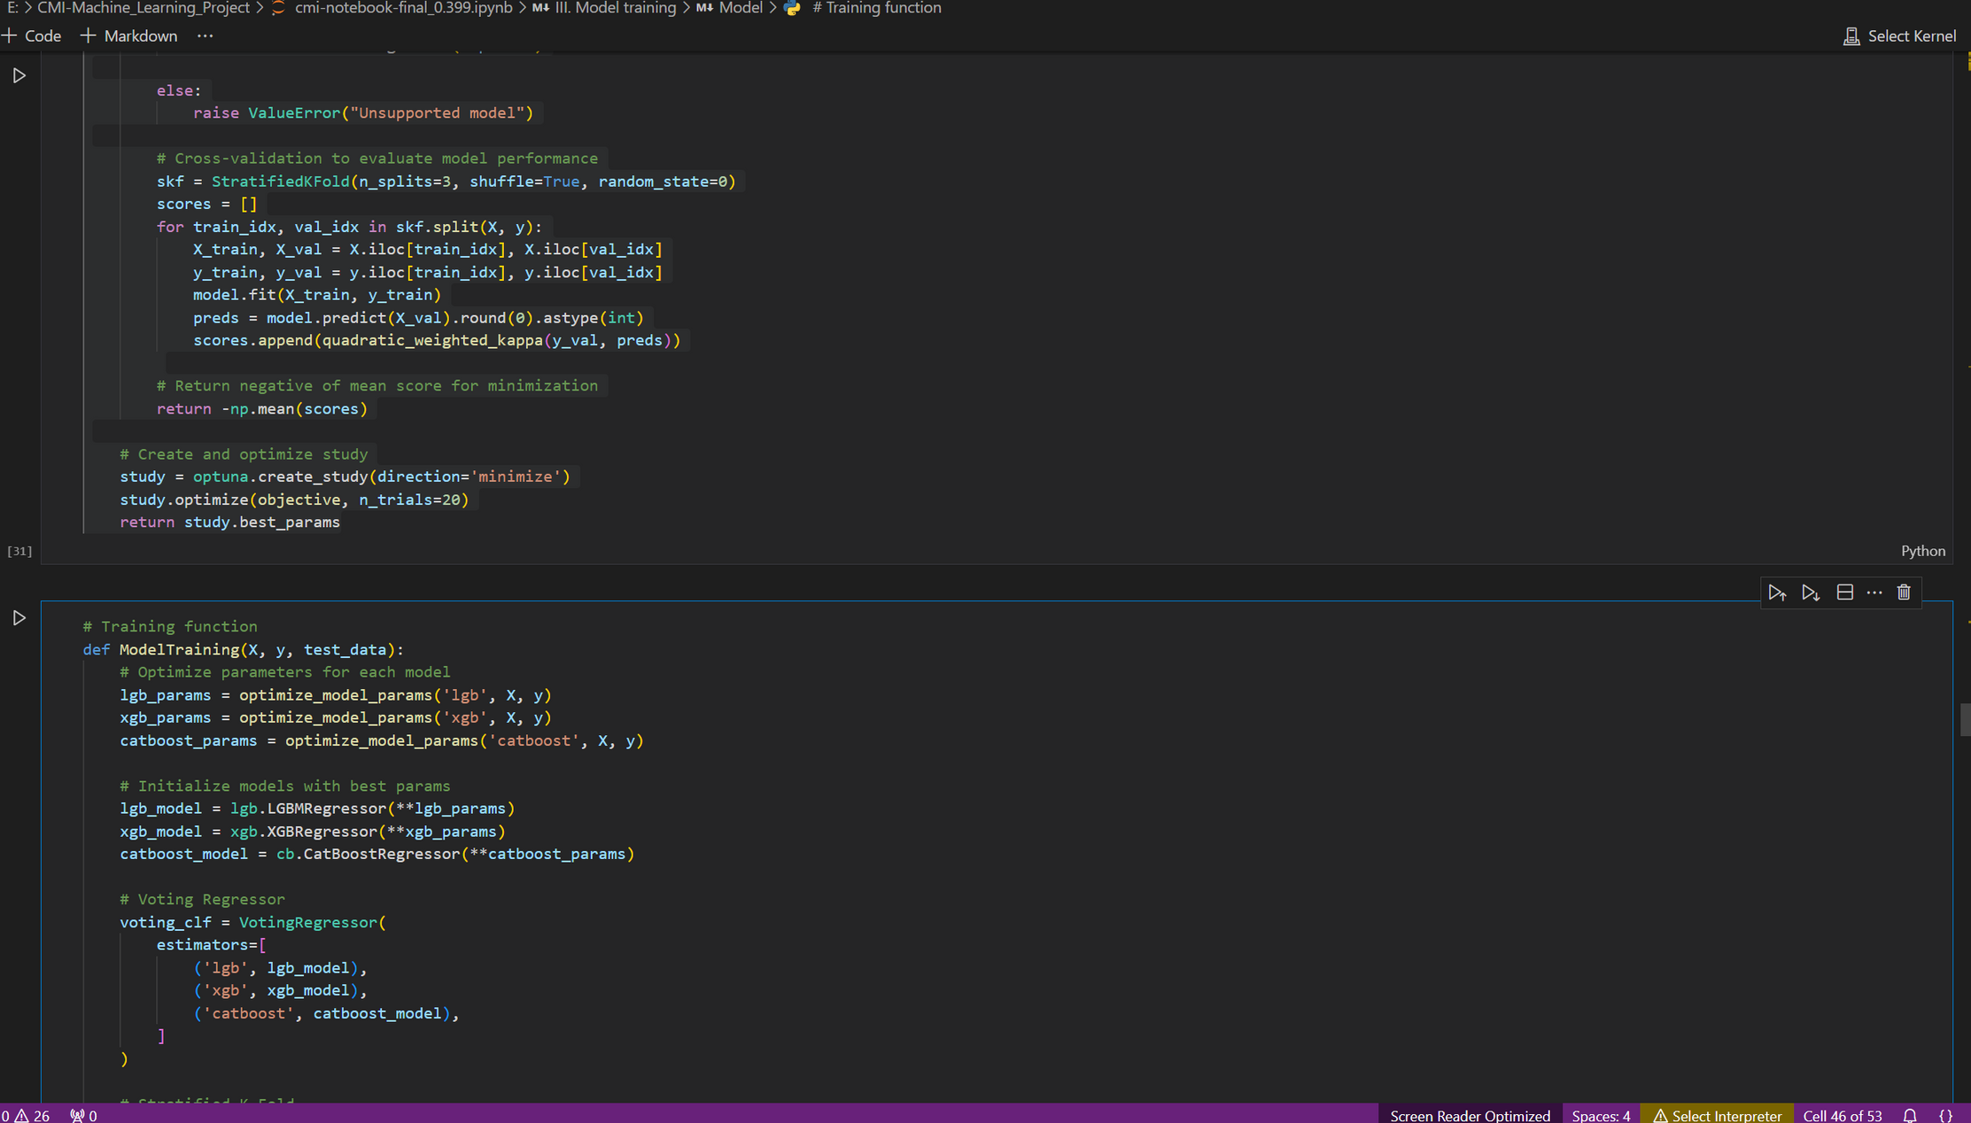
2.METHODOLOGY

Slide 8





Nomad Team
Machine learning process
Exploratory Data Analysis (EDA)
Preprocessing & Feature Engineering
Choosing & training model
Model optimization
Model evaluation
iterate to create the best model

Slide 9
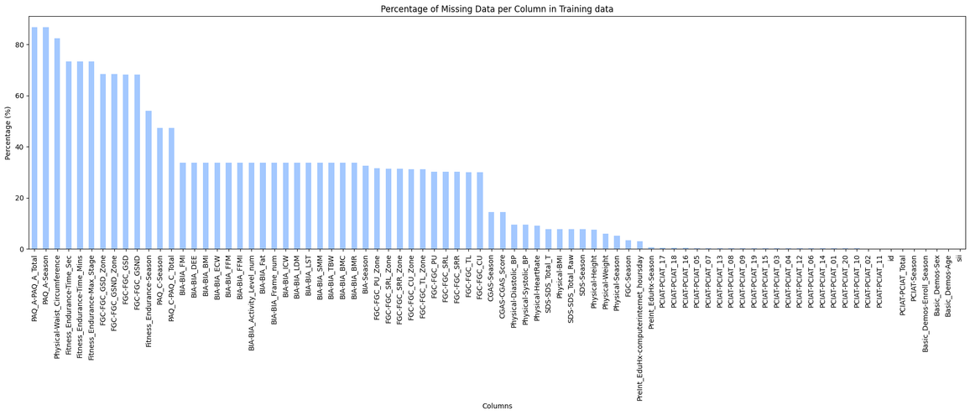

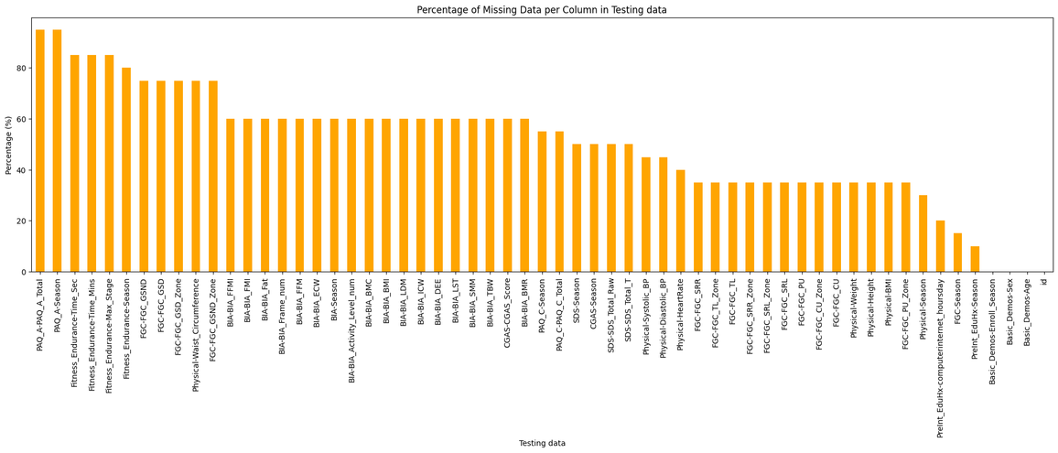

Nomad Team
Exploratory Data Analysis
Training
Contains 3960 samples and 80 features (excluding id and target sii).
2736 non-null sii can be used
for 2736 non-null sii entries
Testing
Contains 20 samples and 58 features (excluding id) , has no 22 PCIAT results.

Slide 10

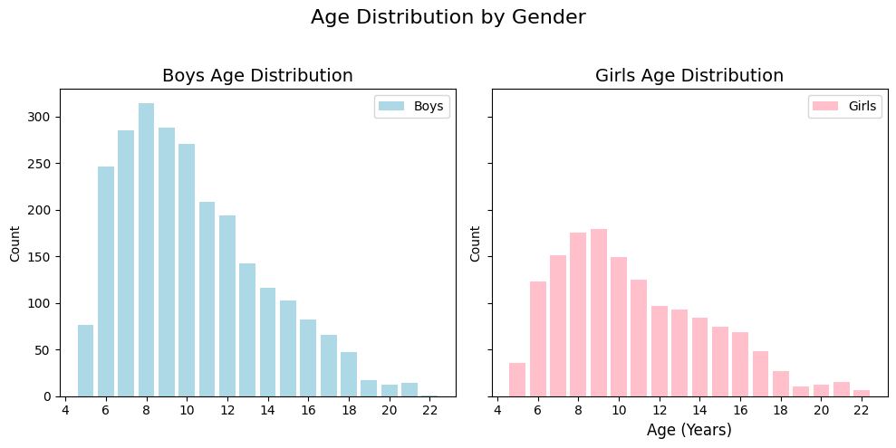
Nomad Team
Exploratory Data Analysis
Classification Insight
Distribution Insight
Demographics
31
24
14
12
Health and Physical Data
Physical-BMI:
Mean BMI is ~19.1, typical for children and adolescents.
BMI of 0 is invalid and indicates null values in that sample.
Physical-HeartRate, Physical-Systolic_BP, Physical-Diastolic_BP:
Average heart rate is ~81.82 bpm, and average systolic/diastolic blood pressure is ~117.12/69.75, which are within normal ranges.
80 features +1 id is divided into 4 classes.

Slide 11
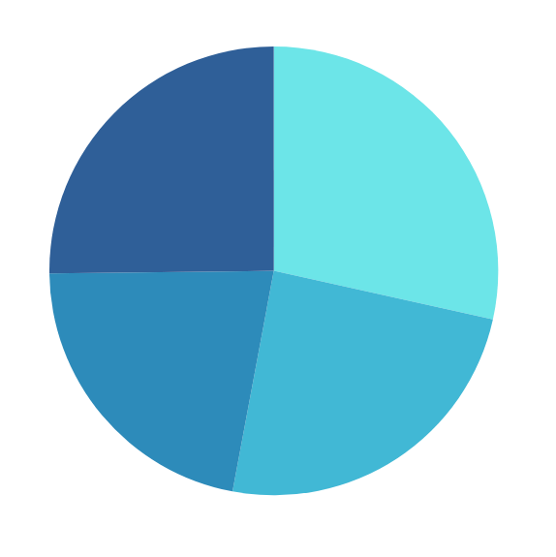
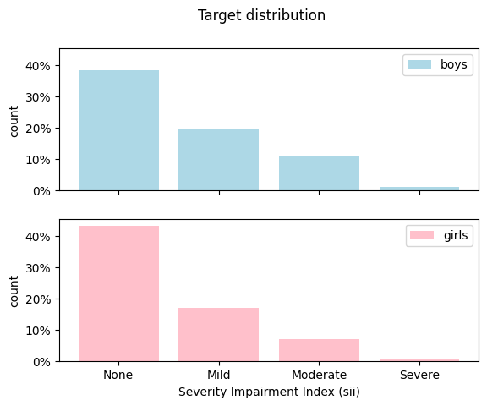
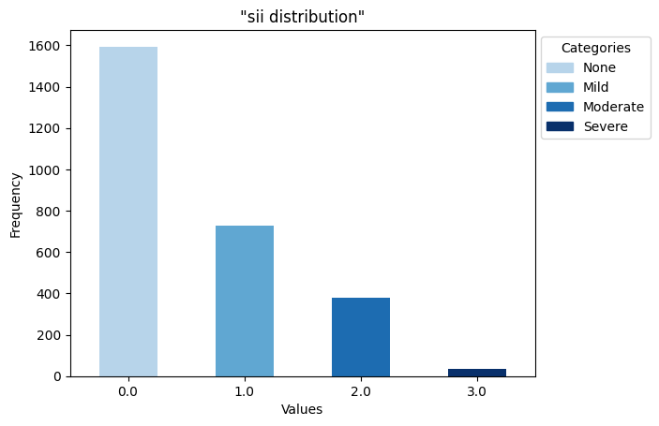
Nomad Team
Exploratory Data Analysis
Distribution Insight
Season features
Target sii
Males have a slightly higher risk of internet addiction than girls.
In general, imbalanced target variable, mostly in "None" or "Mild" categories.
Season of Enrollment

Slide 12
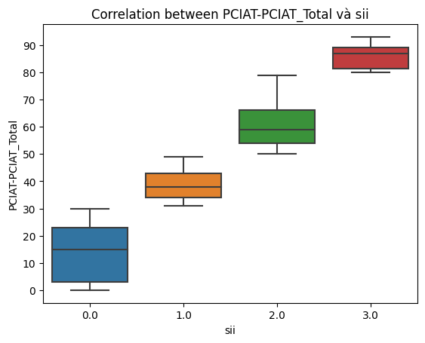
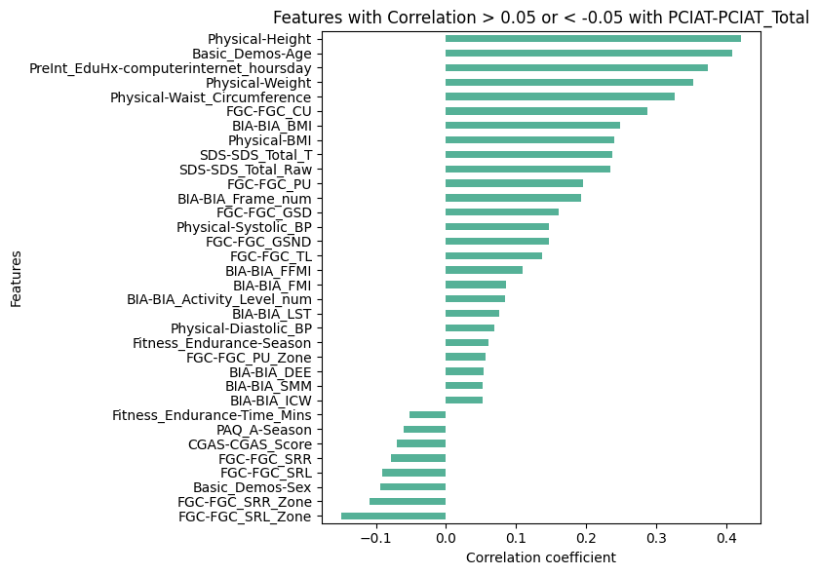
Nomad Team
Exploratory Data Analysis
Correlation Analysis
sii is available exactly for participants with PCIAT scores.
It is a function of the PCIAT total score.
Categories:
0-30 Normal (0)
31-49 Mild (1)
50-79 Moderate (2)
80-100 Severe (3)
Insight:
We focus on predicting the target from all other features except the PCIAT results.
There are 2 approaches: directly predict sii or predict `PCIAT-PCIAT_Total` and then transform this prediction to a sii prediction for submission.

Slide 13

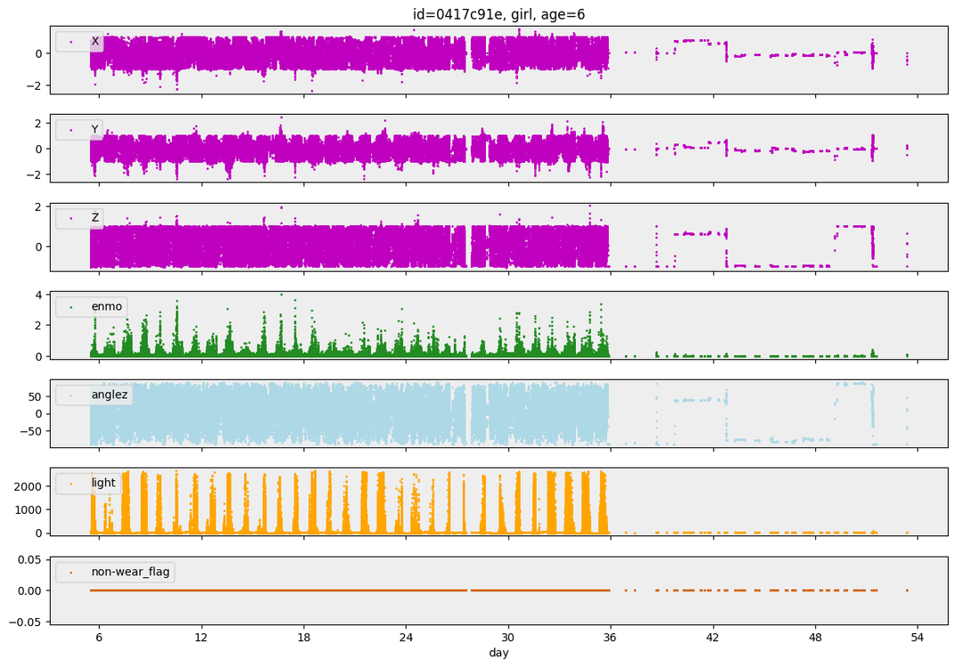

Nomad Team
Exploratory Data Analysis
Actigraphy Data
Actigraphy: Non-invasive method to monitor rest/activity cycles.
Data: 996 participants with files named part-0.parquet.
Example Analysis:
Daily patterns observed.
Non-wear_flag is zero but she wore the accelerometer for 31 days
Illuminance often exceeds 2500 lux.
Frequent movement observed.
Contained measurements every 5 seconds, but some time steps were missing
Insight:
Some columns may not be useful.
Use basic aggregations of time series for gradient-boosting models or one-dimensional convolutional neural networks.

Slide 14

Nomad Team
Preprocessing & Feature engineering
Handling missing data in the "sii" Column
Drop the records with missing sii values
Mapping:
Fall → 0
Spring → 1
Summer → 2
Winter → 3
Use Label Encoding to convert categorical season labels into numerical values. If the value is empty (NaN), keep it NaN.
Encoding Seasonal columns
Encode
Loading
Build AutoEncoder for dimensional reduction with data.
autoencode_data:
Data scaled using StandardScaler.
AutoEncoder compresses into a 50-dimensional representation.
Model trained with Adam optimizer and Mean Squared Error (MSE) loss function.
Encoded features added to new DataFrame.
process_file: read each file and aggregate results into DF with descriptive statistics.
load_time_series: use ThreadPoolExxecutor to load and process multiple time-series data files in parallel.
Processing Actigraphy Data
Select 58 features from the testing DataFrame.
Quality Check: Filtered out columns with missing values >50%.
Feature Selection
Merged Data: Combined selected features with actigraphy data on common id values, resulting in selected_df with shape (2736, 97).
Imputation of Missing Data
Use IterativeImputer:
predicts missing values using other features, updating replacements iteratively.

Slide 15
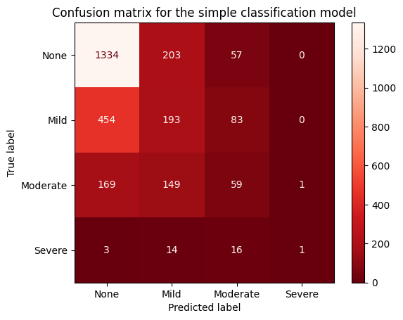
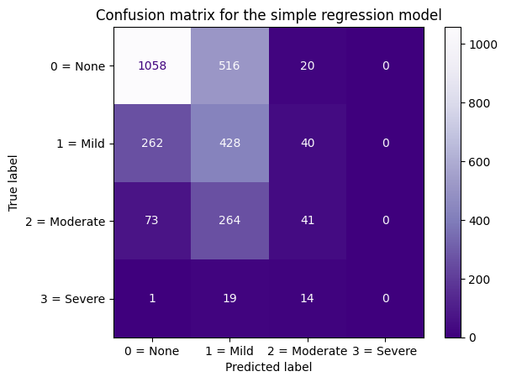


Nomad Team
Model type Selection
test both models in the same dataset, training through 5 folds by StratifiedKFold, evaluate by Cohen’s Kappa Score
Classification Model
Regression Model
Fold 0: score=0.354
Fold 1: score=0.350
Fold 2: score=0.265
→ Overall: score=0.331 (classification with LightGBM)
Fold 3: score=0.317
Fold 4: score=0.379
Fold 0: score=0.360
Fold 1: score=0.422
Fold 2: score=0.355
→ Overall: score=0.389 (regression with LightGBM)
Choose Regression Model because of better result.
(Round float value prediction to integers at Threshold [0.5, 1.5, 2.5] )
Fold 3: score=0.384
Fold 4: score=0.426

Slide 16

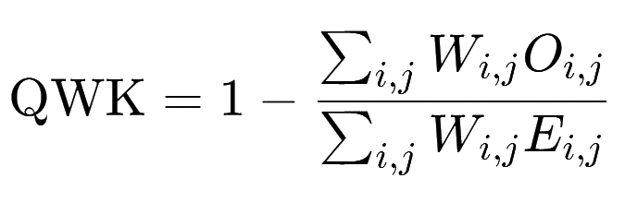

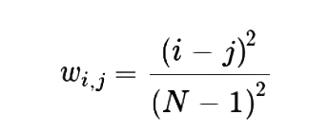

Nomad Team
Evaluation Metrics
Evaluate the performance of models using Quadratic Weighted Kappa (QWK).
Ensure robust and reliable performance metrics with Stratified K-fold cross-validation
Weighting factor
Observed frequency
Expected frequency

Slide 17
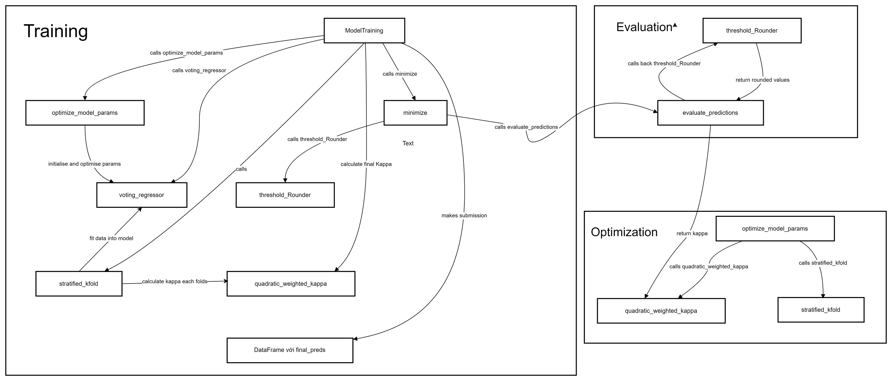
Nomad Team
Model Implementation
Diagram of general model workflow

Slide 18
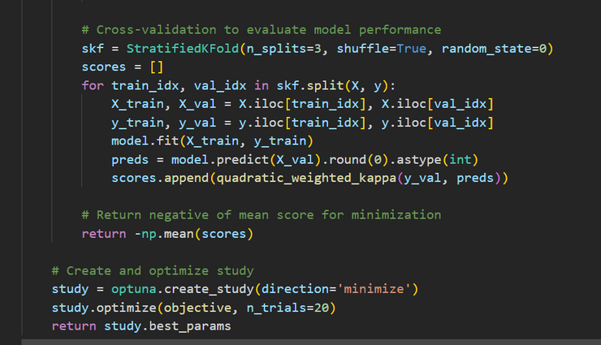

Nomad Team
Model Implementation
Step 1:
Model Selection and Hyperparameter Optimization
Voting Regressor
LightGBM
XGBoost
CatBoost
optimised params
optimised params
optimised params
Defines the range of hyperparameters for each model.
Uses Stratified K-fold cross-validation to evaluate model performance.
Calucluate and minimize the negative mean QWK score.
Best parameters selected after 20 trials by Optuna
optimize_model_params

Slide 19
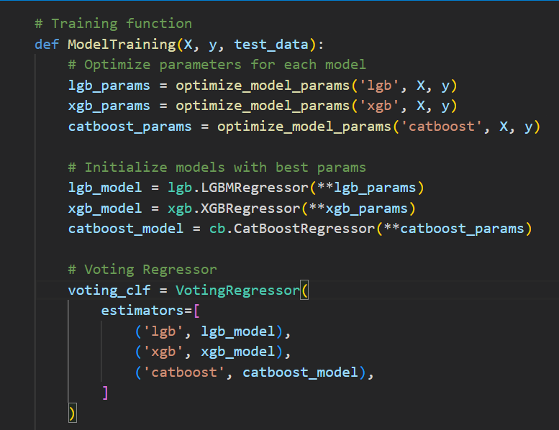
Nomad Team
Model Implementation
Step 2:
Initilization
X: Feature set for training.
y: Target variable (sii) for training.
test_data: Data used for making predictions after the model is trained.
optimize parameters
initialize with best parameters.
Initialize Voting Regressor

Slide 20
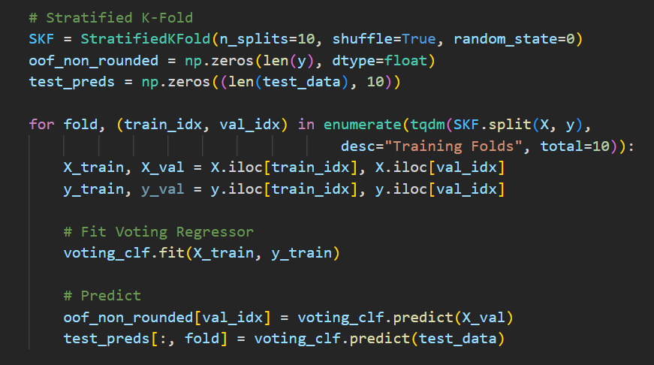
Nomad Team
Model Implementation
Step 3:
Model Training
use Stratified K-Fold cross-validation, splits the data into 10 parts
training each fold
store predictions on the validation data
store predictions on the test data

Slide 21
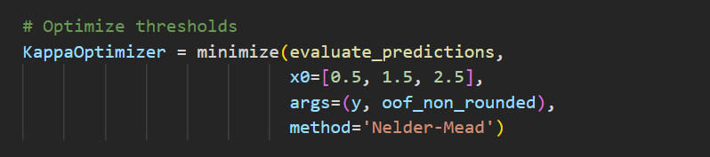

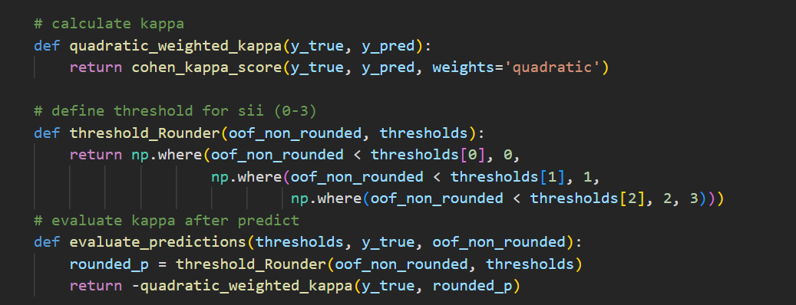
Nomad Team
Model Implementation
Step 4:
Optimization & Evaluation
After training, predictions are rounded into discrete values using the threshold_Rounder function.
“minimize” function optimizes thresholds with the Nelder-Mead method to maximize the Kappa score (minimize negative kappa) .
calculate QWK
round value to threshold 0-3 (sii)
evaluate negative kappa after rounded

Slide 22
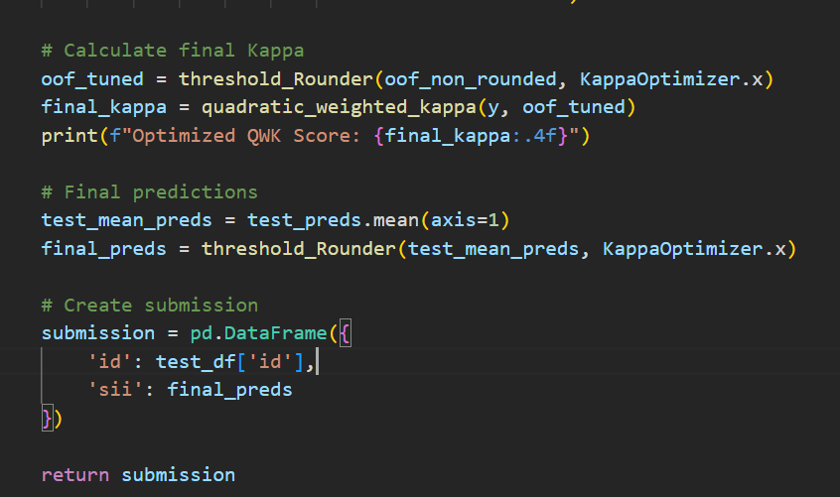
Nomad Team
Model Implementation
Step 5:
Final Predictions and Submission
Optimal thresholds are used to make final test predictions. Predictions are averaged across folds, rounded with the optimized thresholds, and saved in the required submission format.

Slide 23
3.RESULT

Slide 24

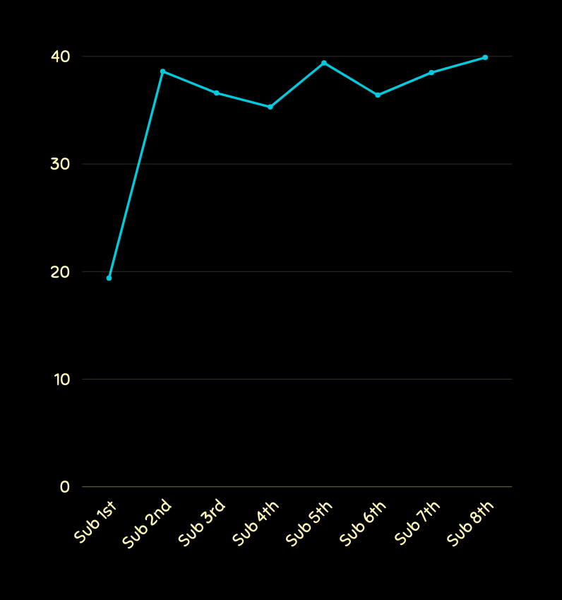
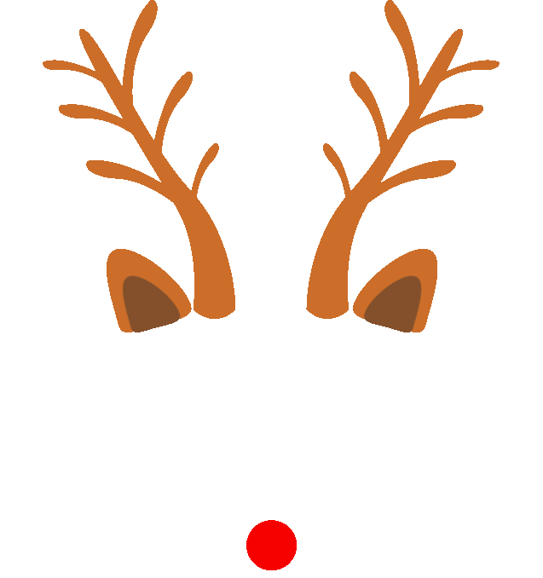


id | sii
00008ff9 | 1
000fd460 | 0
00105258 | 0
00115b9f | 0
0016bb22 | 0
001f3379 | 1
0038ba98 | 1
0068a485 | 0
0069fbed | 1
0083e397 | 0
0087đ65 | 0
00abe655 | 0
00ae58c9 | 1
00af6387 | 1
00bd4359 | 1
00c0cd71 | 1
00d56d4b | 0
00d9913d | 0
00e6167c | 1
00ebc35d | 0
Score (0.)
Submission Result
result of final model
11: sii 0
9: sii 1
Score: 0.399
Submission
Submission score through the times

Slide 25
Nomad Team
Comparison
Comparison of some of the progressing versions submitted to see the improvement of the new model compared to the old models.
Version | Score | Key improvement
1st | 0.194 | It is the first model, actigraphy data was not used. Features chosen for selection were only 16 columns that have a correlation with Total_PCIAT. The encoding of the season data failed (NaN values were not handled, so NaNs were set to 4 by default, which corresponds to the fifth season value) Use the classification model.
2nd | 0.386 | The issue with encoding the season data has been resolved. Actigraphy data was used and encoded using an AutoEncoder. The number of features selected for training (excluding Acti) is 29 Use the regression model.
5th | 0.394 | All the features in Test data were chosen (58) then filtered with missing (remaining 48)
8th | 0.399 | Before training, construct a function to optimize model hyperparameters using Optuna to maximize the quadratic weighted Kappa (QWK) score. The optimize_model_params function defined parameter ranges for LightGBM, XGBoost, and CatBoost, using Stratified K-fold cross-validation to select the best parameters by minimizing the negative mean QWK score.

Slide 26
Nomad Team
Conclusion
We done
Developed a predictive model for assessing problematic internet usage using a robust dataset and advanced machine learning techniques.
Use Actigraphy integration via AutoEncoders, hyperparameter tuning with Optuna, and a Voting Regressor combining LightGBM, XGBoost, and CatBoost.
Significantly enhancing the QWK score by optimize thresholds crossing Fold

Slide 27
Thank You
So Much
Dec 2024
INT3405E_56
Nomad Team

